Slide 1


Data Structures
Week 14 MST and Prim’s Algorithm
Juan Carlos Pineda
ITESM
juancarlos.pineda@tec.mx

Slide 2
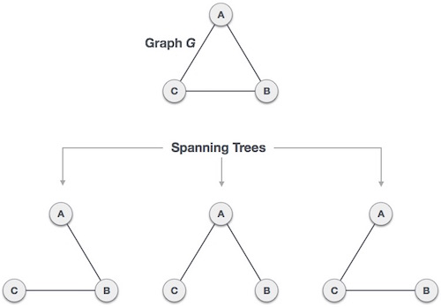
Spanning Tree
A spanning tree is a subset of Graph G, which has all the vertices covered with minimum possible number of edges. Hence, a spanning tree does not have cycles and it cannot be disconnected..
By this definition, we can draw a conclusion that every connected and undirected Graph G has at least one spanning tree. A disconnected graph does not have any spanning tree, as it cannot be spanned to all its vertices.

Slide 3
Spanning Trees
We found three spanning trees off one complete graph. A complete undirected graph can have maximum nn-2 number of spanning trees, where n is the number of nodes. In the above addressed example, n is 3, hence 33−2 = 3 spanning trees are possible.

Slide 4
Properties of Spanning Tree
We now understand that one graph can have more than one spanning tree. Following are a few properties of the spanning tree connected to graph G −
A connected graph G can have more than one spanning tree.
All possible spanning trees of graph G, have the same number of edges and vertices.
The spanning tree does not have any cycle (loops).
Removing one edge from the spanning tree will make the graph disconnected, i.e. the spanning tree is minimally connected.
Adding one edge to the spanning tree will create a circuit or loop, i.e. the spanning tree is maximally acyclic.

Slide 5
Minimum Spanning Tree (MST)
In a weighted graph, a minimum spanning tree is a spanning tree that has minimum weight than all other spanning trees of the same graph. In real-world situations, this weight can be measured as distance, congestion, traffic load or any arbitrary value denoted to the edges.

Slide 6

Greedy Algorithms
As the name implies, this is a simple approach which tries to find the best solution at every step. Thus, it aims to find the local optimal solution at every step so as to find the global optimal solution for the entire problem.
Consider that there is an objective function that has to be optimized (maximized/ minimized). This approach makes greedy choices at each step and makes sure that the objective function is optimized.
Notes:
The greedy algorithm has only one chance to compute the optimal solution and thus, cannot go back and look at other alternate solutions. However, in many problems, this strategy fails to produce a global optimal solution.

Slide 7
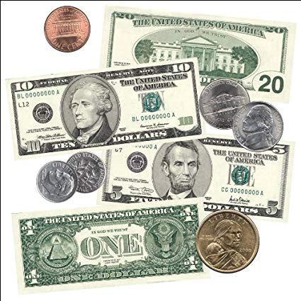
Example
Let’s suppose you have an infinite number of $20, $10 and $5 dollar bills.
Now, suppose you have a friend who asks you for an x amount of dollars, for this example,
x = 50.
You could give him
10 5-dollar bills
Or
One $20 plus six $5’s
Or
One $20, one $10 and four $5’s

Slide 8
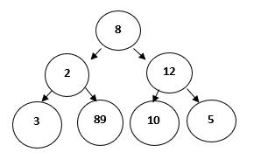
Greedy Approach
Let's consider the following binary tree to understand how a basic greedy algorithm works:

Slide 9
Greedy Approach
For the above problem the objective function is:
To find the path with largest sum.
Since we need to maximize the objective function, Greedy approach can be used. Following steps are followed to find the solution:
Step 1: Initialize sum = 0
Step 2: Select the root node, so its value will be added to sum, sum = 0+8 = 8
Step 3: The algorithm compares nodes at next level, selects the largest node which is 12, making the sum = 20.
Step 4: The algorithm compares nodes at the next level, selects the largest node which is 10, making the sum = 30.
Thus, using the greedy algorithm, we get 8-12-10 as the path. But this is not the optimal solution, since the path 8-2-89 has the largest sum ie 99.
Notes:
When to use Greedy Algorithms?
For a problem with the following properties, we can use the greedy technique:
Greedy Choice Property: This states that a globally optimal solution can be obtained by locally optimal choices.
Optimal Sub-Problem: This property states that an optimal solution to a problem, contains within it, optimal solution to the sub-problems. Thus, a globally optimal solution can be constructed from locally optimal sub-solutions.
Generally, optimization problem, or the problem where we have to find maximum or minimum of something or we have to find some optimal solution, greedy technique is used.
An optimization problem has two types of solutions:
Feasible Solution: This can be referred as approximate solution (subset of solution) satisfying the objective function and it may or may not build up to the optimal solution.
Optimal Solution: This can be defined as a feasible solution that either maximizes or minimizes the objective function.

Slide 10
Key Terminologies used in Greedy Algorithms
Objective Function: This can be defined as the function that needs to be either maximized or minimized.
Candidate Set: The global optimal solution is created from this set.
Selection Function: Determines the best candidate and includes it in the solution set.
Feasibility Function: Determines whether a candidate is feasible and can contribute to the solution.

Slide 11
Standard Greedy Algorithm
Standard Greedy Algorithm
This algorithm proceeds step-by-step, considering one input, say x, at each step.
If x gives a local optimal solution (x is feasible), then it is included in the partial solution set, else it is discarded.
The algorithm then goes to the next step and never considers x again.
This continues until the input set is finished or the optimal solution is found.
Notes:
Advantages of Greedy Approach/Technique
This technique is easy to formulate and implement.
It works efficiently in many scenarios.
This approach minimizes the time required for generating the solution.
Now, let's see a few disadvantages too,
Disadvantages of Greedy Approach/Technique
This approach does not guarantee a global optimal solution since it never looks back at the choices made for finding the local optimal solution.
Although we have already covered that which type of problem in general can be solved using greedy approach, here are a few popular problems which use greedy technique:
Knapsack Problem
Activity Selection Problem
Dijkstra’s Problem
Prim’s Algorithmfor finding Minimum Spanning Tree
Kruskal’s Algorithmfor finding Minimum Spanning Tree
Huffman Coding
Travelling Salesman Problem

Slide 12
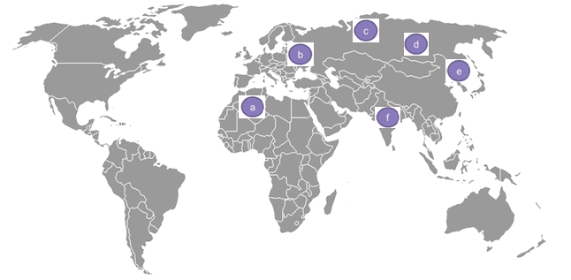
Prim’s Algorithm
Let's start with a real-life scenario to understand the premise of this algorithm:
A telecommunications organization, has offices spanned across multiple locations around the globe.

Slide 13
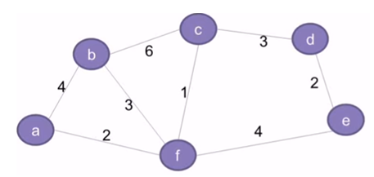
Introduction
It has to use leased phone lines for connecting all these offices with each other.
The cost(in units) of connecting each pair of offices is different and is shown as follows:

Slide 14
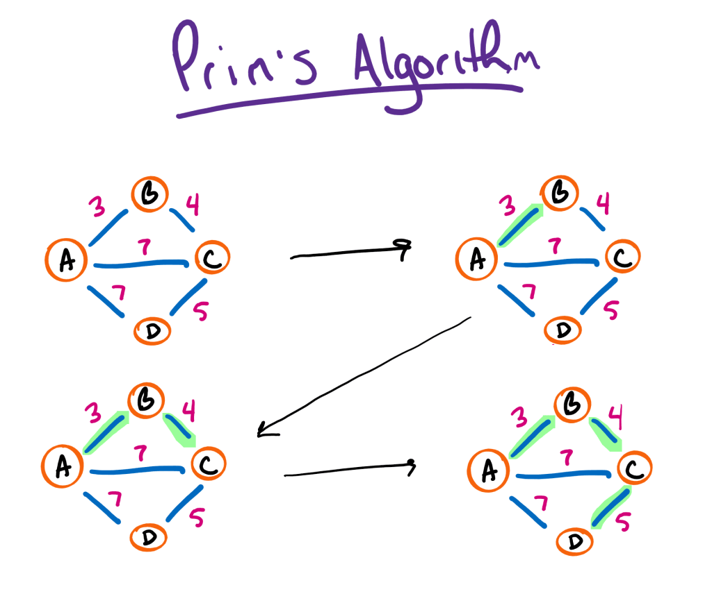
Introduction
4. The organization, thus, wants to use minimum cost for connecting all its offices. This requires that all the offices should be connected using minimum number of leased lines so as to reduce the effective cost.
5. The solution to this problem can be implemented by using the concept of Minimum Spanning Tree

Slide 15
Prim’s Algorithm
Step 1: Keep a track of all the vertices that have been visited and added to the spanning tree.
Step 2: Initially the spanning tree is empty.
Step 3: Choose a random vertex, and add it to the spanning tree. This becomes the root node.
Step 4: Add a new vertex, say x, such that
x is not in the already built spanning tree.
x is connected to the built spanning tree using minimum weight edge. (Thus, x can be adjacent to any of the nodes that have already been added in the spanning tree).
Adding x to the spanning tree should not form cycles.
Step 5: Repeat the Step 4, till all the vertices of the graph are added to the spanning tree.
Step 6: Print the total cost of the spanning tree.

Slide 16
End of presentation

